Slide 1
Transactional Event Profiling in a Best Effort HTM
Matthew Gaudet
Supervisor: José Nelson Amaral (University of Alberta)
Collaborators: Amy Wang (IBM Toronto), Peng Wu (IBM TJ Watson)

Slide 2
The Story.
Transactions | Aborts | Serializations
1042 | 200 | 10
1000 Aborts | 1000 Aborts
1 abort / second | 1000 aborts / second
Notes:
Most TM systems seem to give summary statistics; Sometimes this is per thread, sometimes this is just for the whole program.
This isn’t really sufficient when you want to start trying to modify the system to affect performance. This is a very coarse metric.
Sometimes you care about rates too! Certainly, intuitively you understand a program which runs for 1000 seconds at 1 abort/second differently than a program which runs for 1 second, but incurs 1000 aborts/ second.

Slide 3
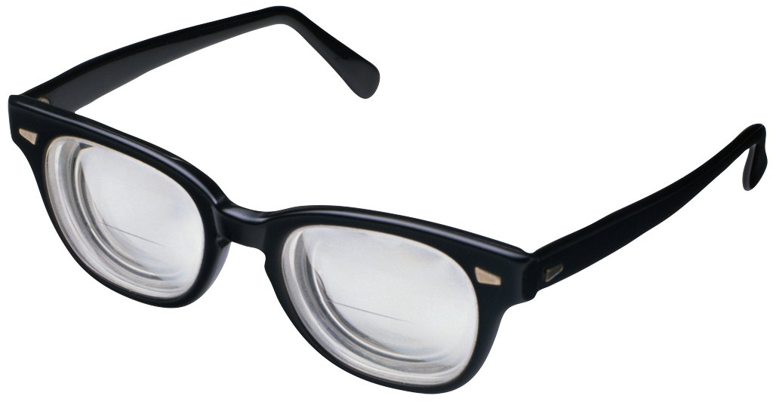
We need a pair of:
X-Ray Specs
Notes:
X-Ray specs!

Slide 4
Event Profiling
Analyzers
Program
Log File
Runtime
Instrumented
Hardware
Notes:
So what we did was instrument the BG/Q TM runtime,

Slide 5
Analyzers
Limited only by the power of your
Imagination!
Notes:
Offline logs are great, because once you have the logs, analysis is limited only to your imagination.

Slide 6
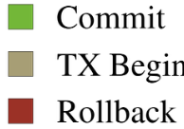
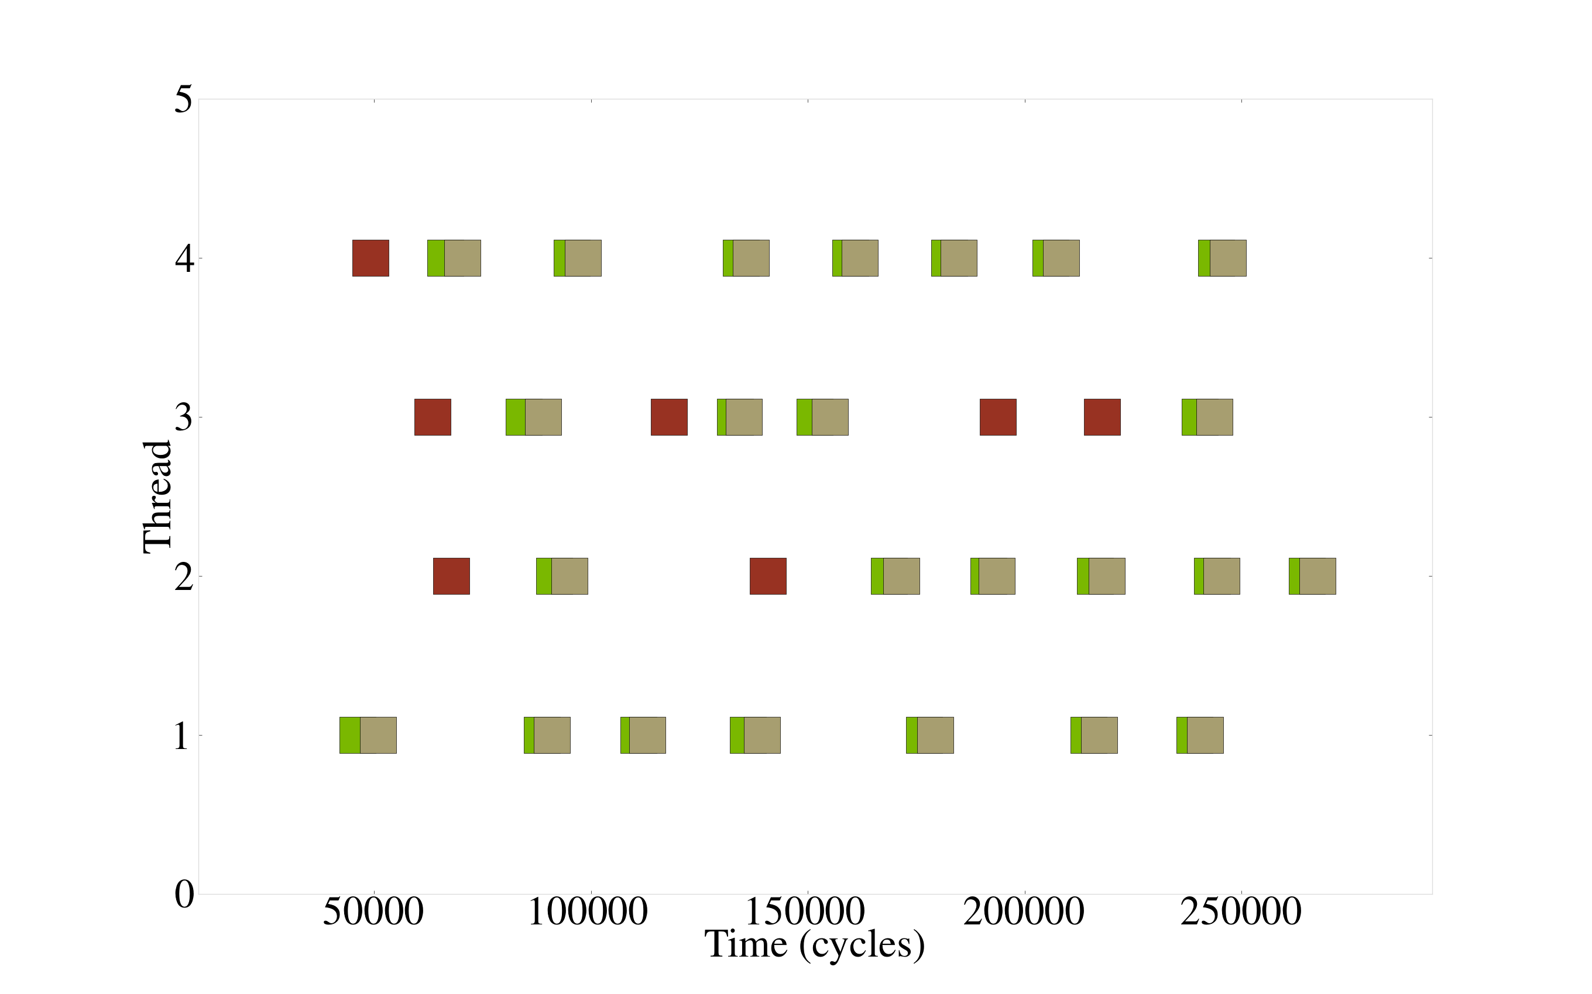
Peeking into execution:
50000 cycles = 0.00003125 seconds
Notes:
So we have this event log, vacation (low) @ 4 threads
This is a snippet of transactional execution.

Slide 7
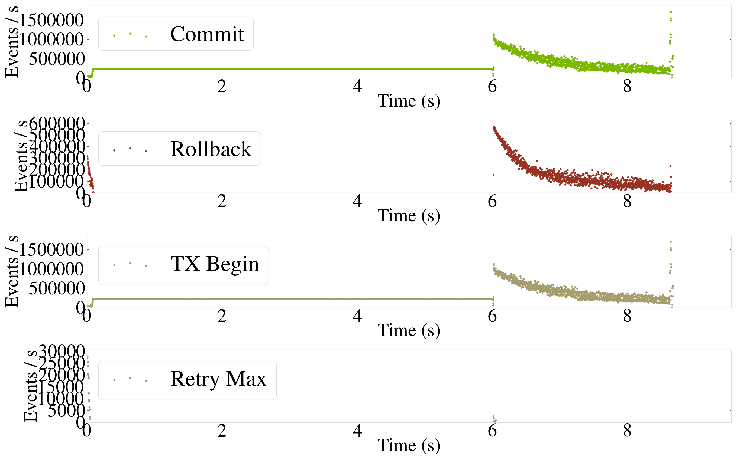
Seeing Rates
As they change
Notes:
If you take those program snippets, and summarize them, you can see rates,
And most importantly, rates as they change over time.

Slide 8
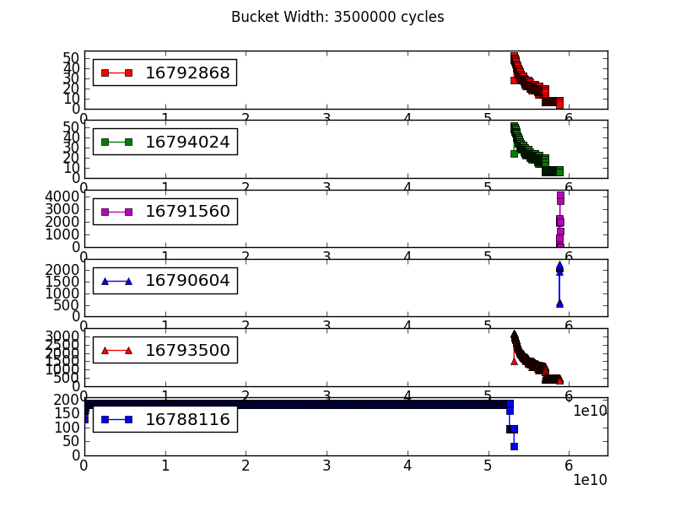
Which transactions are active?
Notes:
Demonstrating which transactions are active in genome; Six static transactions, all but one don’t come into play until last 6th of execution.
(different than last, but you can see perhaps where RB spike comes from).

Slide 9
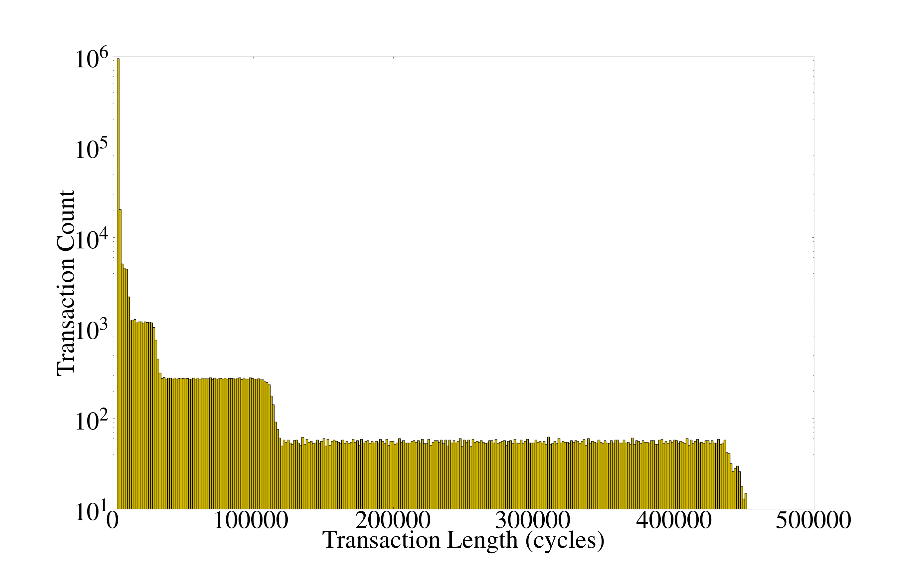
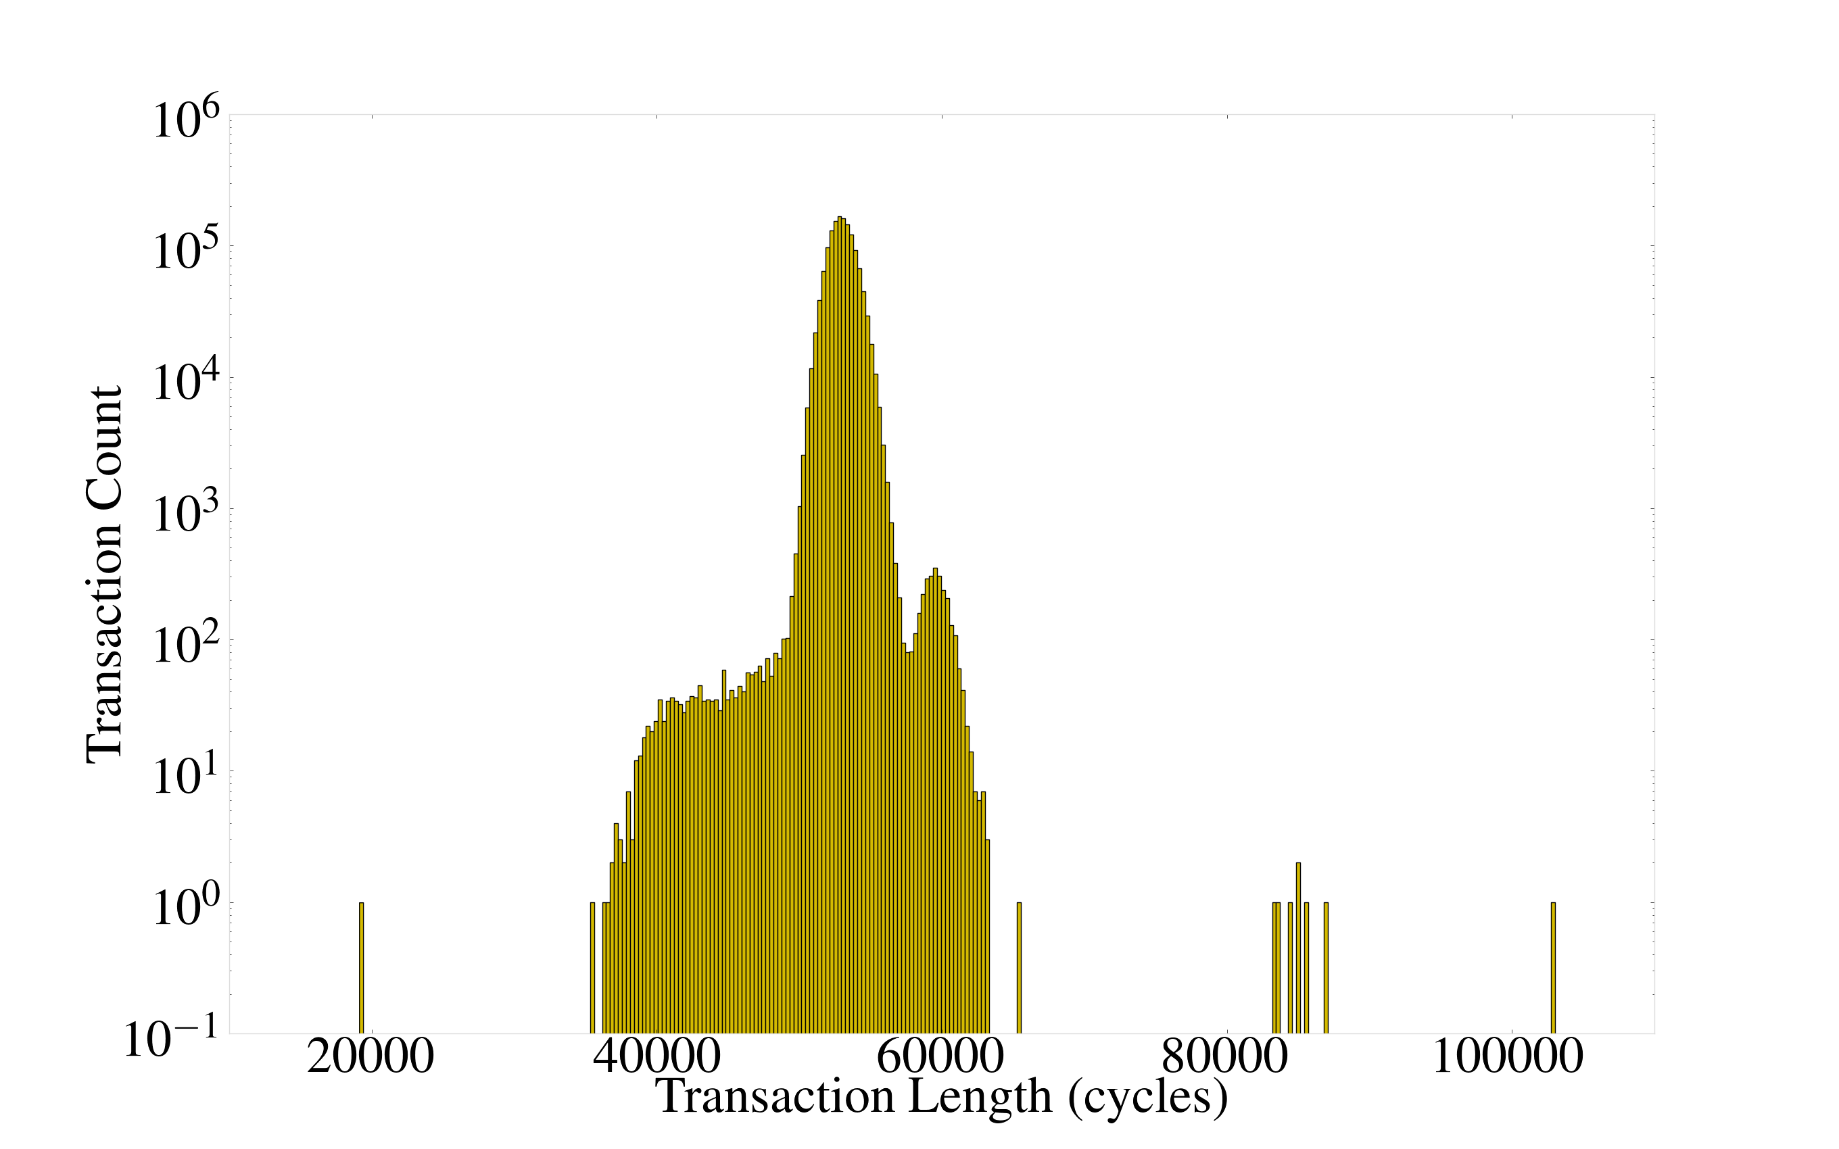
Real TX Length Distributions
Notes:
We can also gather real transaction length distributions and plot them.
Both different TX from geneome, 1 thread. This prevented us from going down a bad road of trying to model transaction lengths as normal distributions. → can extract same data @ 64 threads (messier).

Slide 10
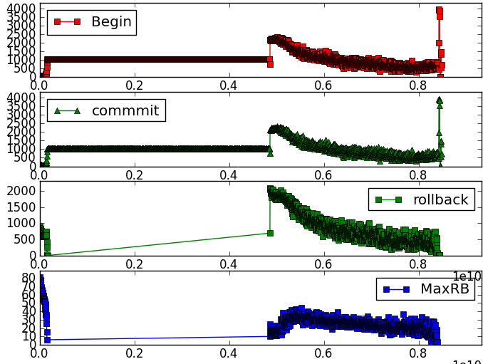
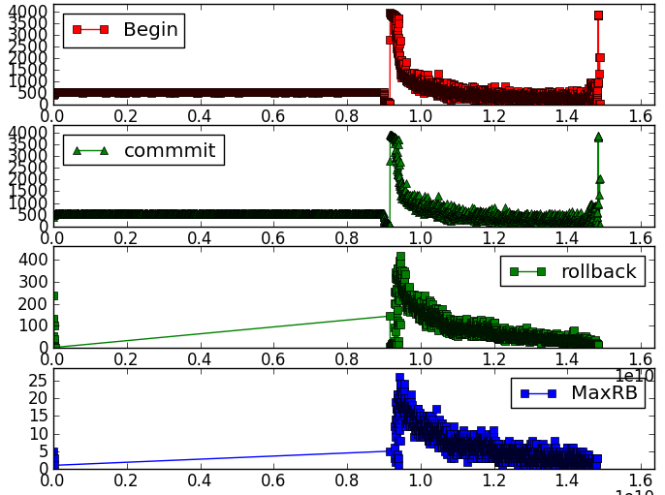
Details matter
LR Mode
SR Mode
Notes:
We need to pay attention sometimes when comparing these charts
Look fairly similar in both cases: Both are genome, 16 threads. But one, if you look at the x axis, takes a lot longer… Turns out what we’re seeing is a begin rate in SR mode that’s half of the begin rate in LR mode.

Slide 11
Probe effects
Notes:
Probe effects can be small… but also can be big. s

Slide 12
Using this
Want to improve performance on BG/Q
(Judicious) Serialization
When?
Too little?
Bad performance
Too Much?
Bad performance
Solution: Runtime Adaptation
Notes:
So we want to do adaptation.

Slide 13
Understanding What’s going on?
Notes:
Understanding what’s going on is very painful without event logging.
Suppose you’re making a prediction based on some parameter which is supposed to change over program execution:

Slide 14
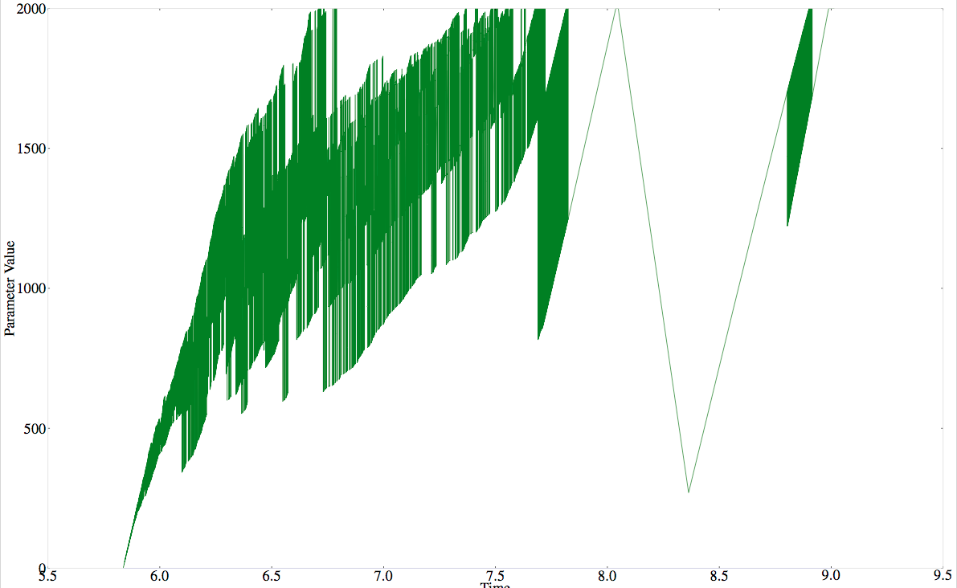
Solution:
Correct decisions requires dynamic information
Notes:
Piggyback on event logs and annotate logs with parameter values of interest.
This is a log of a particular parameter from an adaptation scheme that I was unhappy with the performance of.
Turns out I had set the limit way too high!

Slide 15
Future Work
The ability to zoom and explore log files, like Visualizing Transactions
Support for longer, larger programs: In memory compression, partial log-dumps.
Notes:
Presented this morning.

Slide 16
Conclusion
Event Logging provides a useful view of transactional execution

